Slide 1


Back Workout
Lawrence Hua
CMU MISM, (gym rat)

Slide 2
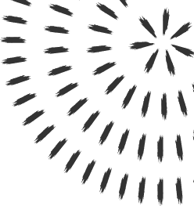
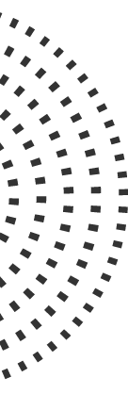

Slide 3
REPITIONS

Slide 4
REPITIONS

Slide 5
Thank you!

